Slide 1



Simple Manager
Employee management system
By TechServerBD

Slide 2

Team Members
Md. Firoz Abdullah
Intake – 43, Section -2
Roll: 22231203059
Dept. of CSE
Md. Firoz Abdullah
Intake – 43, Section -2
Roll: 22231203059
Dept. of CSE
Md. Firoz Abdullah
Intake – 43, Section -2
Roll: 22231203059
Dept. of CSE

Slide 3
What is Employee Management System?

Slide 4
What is Employee Management System?
An employee management system is technology designed to streamline core HR services and improve workforce productivity.

Slide 5

Benefits of An Employee management System
Efficient Workflow
Accurate Data Management
Time and Attendance Tracking
Performance Management

Slide 6
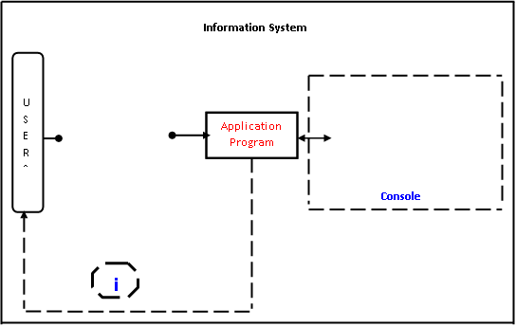
Simple Manager System Diagram

Slide 7
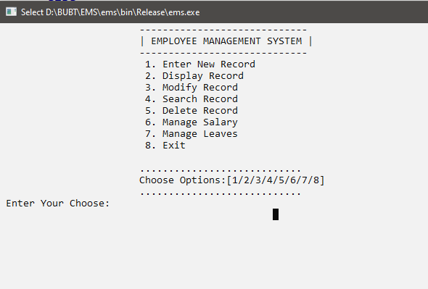
Our Interfaces

Slide 8
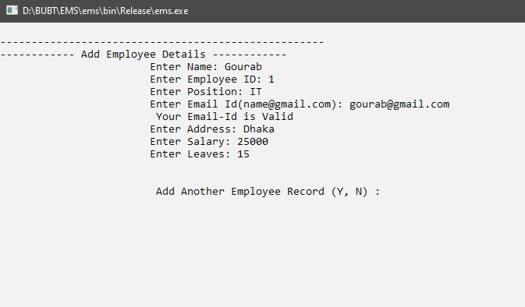
Our Interfaces

Slide 9
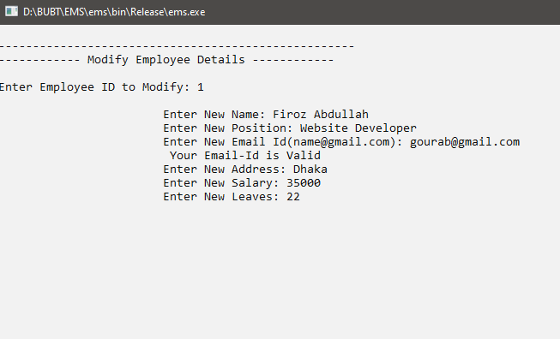
Our Interfaces

Slide 10
Our Interfaces

Slide 11

Challenges
Database Management
Code Refinement
Functions Misfire
File Handling errors

Slide 12

Future Updates
A clean UI
Manageable Database
Clean Functions
File Management
Multiuser Management

Slide 13
Thank you
We will happy to answer any question or query.

